Slide 1

Tourist Guidance System
Group members with student Id
21104041-Yash Jain
21104008 –Karan Jain
21104005-Swapnil Joshi

Slide 2
Contents
Introduction
Objectives
Scope
Features / Functionality
Project Outcomes
Technology Stack
Block Diagram/ Flow

Slide 3
1. Introduction
Problem Identified :
There is always a language barrier between people of two different communities for communication.
People who don’t know to explore places especially for foreigners in India.
Solution Proposed :
Now user don’t have to ask any stanger. User will get the best possible outcomes
The purpose of this project is to provide the complete information about the hotels available for a tour.

Slide 4
2. Objectives
To guide user and prevent him from getting false information from local people.
Major technological upgrades to the current travel system.
Faster processing time and more accurate data for travel requests.
In this user is able to access different hotel details
User is authenticated by taking Password and Email at the time of login

Slide 5
3. Scope
It is applied in tourism sector
It can used by government to promote various tourism sites which people are not aware about.
It is useful to locals as well as foreigners.
Customers are able to decide about places they want to visit and make bookings online for accommodation.

Slide 6
4. Feature /Functionality
Customer can view and book hotels.
We are providing different packages of hotels to user.
We are providing logged in user’s information on profile page.
User can’t enter inappropriate details in registration fields.
User is able to see different Nearby Places based on location provided.

Slide 7
5. Outcome of Project
Profile : User will able to see his/her profile on dashboard.
Places : User is able to see popular nearby places based on the location provided.
Hotels : User will get to see different hotels options and will able to book it.
Hotel details : User will get to see details of different hotels.

Slide 8
6. Technology Stack
Frontend–Tkinter
Backend–Python
Database-Sqlite3

Slide 9
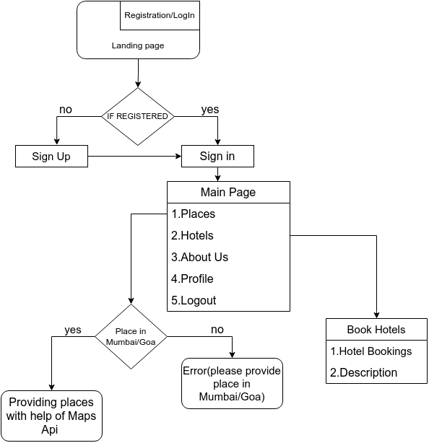
7. Flow Diagram

Slide 10
Thank You...!!

